Slide 1
Pyomo: Python Optimization Modelling Objects
Dr Mostafa Bakhtvar
(mostafa.bakhtvar@ucd.ie)
School of Electrical and Electronic Engineering
University College Dublin

Slide 2

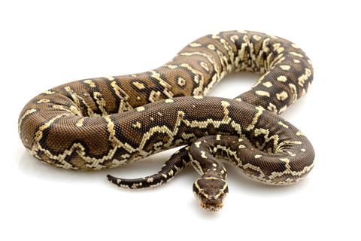

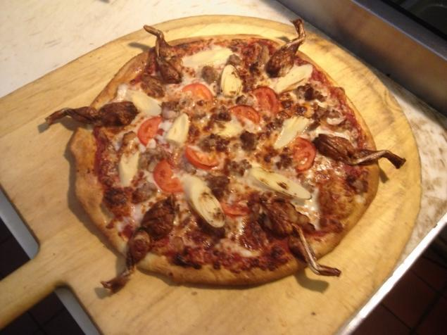
What is Python?

Slide 3


What is Python?
High Level Programming Language
Developed by Guido van Rossum
in 1989 (we are both 27!)
Multi-platform, Dynamic, Object-oriented, Imperative
Open Source
EASY TO LEARN!!!!

Slide 4
Some Basic Python
Data types:
Data Structures:
Float | Integer | String
123.456 19.5 | 1 2 | “heLlo” ‘1989’
List | Dictionary
>> a = [1,2,3,4,“UCD”] >> a[0] -----> 1 >> a[0:2] -----> [1,2] >> a[-1] -----> “UCD” | >> a = {“a”:1, (“a”,2):[1,2]} >> a[“a”] -----> 1 >> a[(“a”,2)] -----> [1,2] >> a[(“a”,2)][0] -----> 1

Slide 5
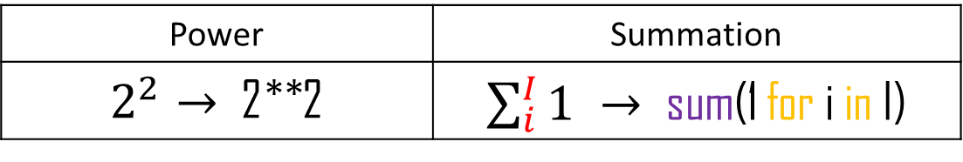
Some Basic Python
Operands:
The rest is similar to Matlab!
Comparators:
Power | Summation
$2^{2}→$ 2**2 | $\sum_{i}^{I}{1} →$ sum(1 for i in I)
Math |  | Identity | Containment
> < == | >= <= != | is is not | in not in

Slide 6
Some Basic Python
Loops and Condition:
For | While | IF
>> a = 0 >> I = [4,5,6] >> for i in I: print i a = 1+a | >> a = 0 >> while a<4: a = a+1 | >> a = 3 >> if a<2: a = a+1 elif a>=2 and a<4: print “UCD” else: a = a-1

Slide 7
Some Basic Python
Function
>> def function_1(input_1,input_2):
a = input_1 + 3
b = input_2 ** 2
return a*b
>> c = function_1(1, 2) -----> c = 16
Import a module
>> import my_library >> from my_library import *
>> c = my_library.function_1(1,2) >> c = function_1(1,2)

Slide 8


What is Pyomo
A Pythonic framework (module) for formulating optimization models
Formulate large models
Separate modelling and data declarations
Enable data import and export in commonly used formats
Model
Data
Problem

Slide 9
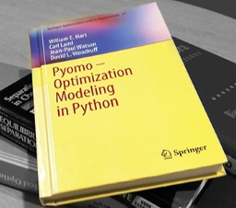
Why Pyomo
Open source, well-maintained, active google group () well documented (even has a book!)
Robust large constraint matrices
Interface to large number of solvers
Ability to use custom solvers: solvers + methods such as Benders decomposition
Automatic Transformation of the problem (this is the NICE part!): Disjunction, MPEC, Piecewise, etc.

Slide 10
So …?
Free yet POWERFUL

Slide 11

Pyomo: model declaration
Types of models
Concrete: a model that is dependent on the data, i.e. data is embedded in it:
$$Min 2.3 x+2.4 x^{2}$$
$$s.t. x>1.2$$
Abstract: a generalized model that is written with symbols, i.e. data can be later fed to it:
$$Min a x+b x^{2}$$
$$s.t. x>c$$
Concrete | Abstract
UCD_model = ConcreteModel() | UCD_model = AbstractModel

Slide 12
Pyomo: abstract model elements
Sets: In optimization, “sets” are the dimensions over which a parameter or variable is defined.
manipulation:
Cross product (multi dimensional): * Union: & intersection: | symmetric difference: ^
UCD_model.set_2 = UCD_model.set_1 * UCD_model.set_1
Initialize and Filter:
UCD_model.set_1 = Set(initialize = [1,2,3])
def lower_tri_filter(UCD_model, i, j):
return j<=i
UCD_model.set_2 = Set(initialize = model.set_1*model.set_1, filter = lower_tri_filter)
UCD_model.set_1 = Set()

Slide 13
Pyomo: abstract model elements
Parameters:
In optimization, parameters are the constants of the problem.
Initialize:
def param_init_rule(UCD_model, i):
return UCD_model.param_1[i] + 1
UCD_model.param_2 = Param(UCD_model.set_1, initialize = param_init_rule)
UCD_model.param_1 = Param(UCD_model.set_1)
Question: Which Python data structure does a parameter use? Array or dictionary? (10 points)

Slide 14
Pyomo: abstract model elements
Variables: In optimization, variables are the unknowns of the problem. We want to find them!
Initialize:
def var_init_rule(UCD_model, i):
if i<2:
return 3.0
else:
return 1.0
UCD_model.var_1 = Var(UCD_model.set_1, initialize = var_init_rule, bounds=(0.0, None))
UCD_model.var_1 = Var(UCD_model.set_1, bounds=(0, 1.5))

Slide 15
Pyomo: abstract model elements
Constraints: The limiters!
def cnstr_1_rule(UCD_model, i):
if i<1:
return (0.0, UCD_model.var_1[i], 0.7)
elif i<2:
return (0.8, UCD_model.var_1[i])
elif model.param_1[i] > 2:
return model.var_1[i] >= 1.2
else:
return Constraint.Skip
UCD_model.cnstr_1 = Constraint(UCD_model.set_1, rule = cnstr_1_rule)

Slide 16
Pyomo: abstract model elements
Objective:
Objective function!
def objective_rule(UCD_model):
return sum(UCD_model.var_1[i] * (2**UCD_mode.param_1[i] ) for i in UCD_model.set_1)
UCD_model.objective_function = Objective(rule = objective_rule,sense=maximize)
minimize

Slide 17
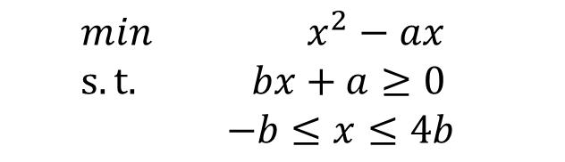
Pyomo: a simple problem
$$min x^{2}−ax$$
$$s.t.{bx+a≥0}$$
$$−b≤x≤4b$$
from pyomo.environ import *
model = AbstractModel()
model.a = Param()
model.b = Param()
model.x = Var()
def objective_function_rule(model):
return (model.x**2 – model.a*model.x)
model.objective_function = Objective(rule = objective_function_rule, sense = minimize)
def constraint_1_rule(model):
return model.b * model.x + model.a >= 0
model.constraint_1 = Constraint(rule = constraint_1_rule)
def constraint_2_rule(model):
return (-model.b, model.x, 4*model.b)
model.constraint_2 = Constraint(rule = constraint_2_rule)
Question: What is missing from our simple problem? (10 Points)

Slide 18
Pyomo: data entry
Sets and Parameters need to be declared
Pyomo takes “my_file.dat”
Enter data directly or tell pyomo where to get it in “my_file.dat”
Direct data entry:
set set_1 := 1 “a” “UCD” ; param param_1 :=
1 1
“a” 2
“UCD” 3
;
Let’s talk about CSV!

Slide 19
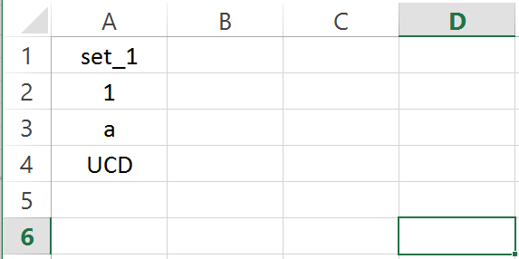
Pyomo: data entry
Importing sets
“set_1.csv”:
“my_data.dat”:
load set_1.csv format=set : set_1;

Slide 20
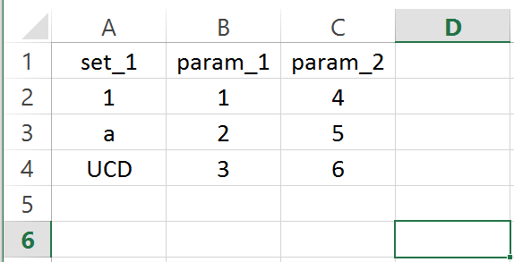
Pyomo: data entry
Importing parameters
“set_1_indexed.csv”:
“my_data.dat”:
load set_1_indexed.csv : [set_1] param_1 param_2 ;

Slide 21
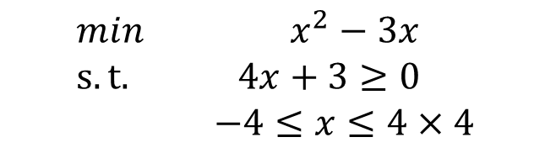
Pyomo: a simple problem
“my_data.dat”:
param a := 3 ;
param b := 4 ;
$$min x^{2}−3x$$
$$s.t.{4x+3≥0}$$
$$−4≤x≤4×4$$

Slide 22
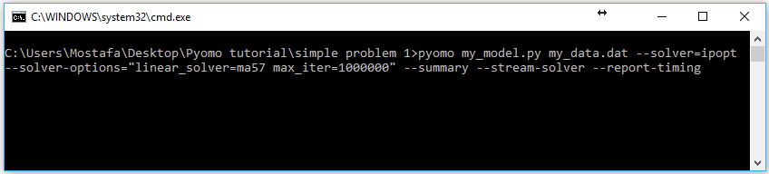
Pyomo: solve the problem
In Command Prompt type in:
pyomo my_model.py my_data.dat --solver=ipopt
--solver-options="linear_solver=ma57 max_iter=1000000“
--summary --stream-solver --report-timing

Slide 23
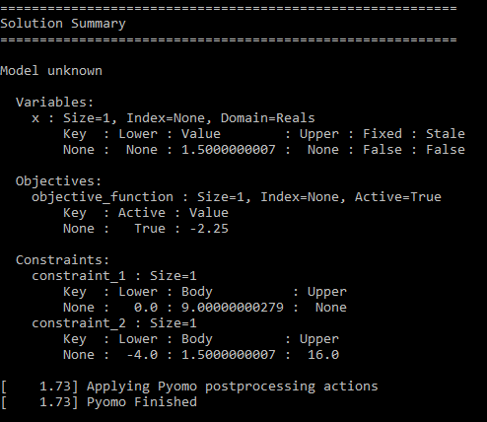
Pyomo: solution

Slide 24
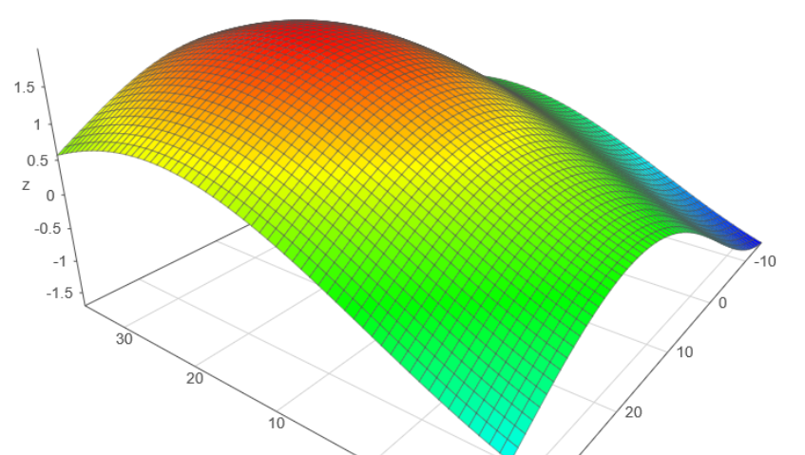

Pyomo: simple problem 2
$$max \sum_{i}^{I}{sin⁡(a_{i}x_{i}∗\frac{π}{180})}$$
$$s.t.{{−3a}_{i}≤x_{i}≤8a_{i}+b_{i}}$$
$$i∈I=\{"t1", "t2"\}$$
a = {“t1”: 4, “t2”:5}
b = {“t1”: 5, “t2”:-3}

Slide 25
Questions?

